Slide 1


CNPC Niger Petroleum S.A.
Computer Basics & Practical Soft Skills
CNPC Niger Petroleum S.A. CNPC Global Solutions Co. Ltd

Slide 2

Training Agenda
Before we start :
Lecture 1 : Foundations & Professional Communication
Lecture 2 : Data, Presentation & Productivity
Lecture 3 : Business Systems & Problem Solving

Slide 3

Let’s Know Each Other
Name:
Occupation / Department /title :
Years of experience / Where ?:
Your Expectation:

Slide 4

Training Objectives
After finalizing this training you should be able to
Computer Hardware: Identify components, connect peripherals, and perform basic troubleshooting.
Excel: Use essential formulas, sort/filter data, and create basic charts.
PowerPoint: Create clean, professional slides and insert objects (images, charts).
Word: Apply consistent formatting (styles, headers) and use Track Changes.
Outlook: Write professional emails, organize their inbox, and manage their calendar.
ERP: Define what an ERP system is and explain its purpose in the business.
Workplace Etiquette: Demonstrate professional conduct in physical and virtual settings.
Communication: Practice active listening and communicate ideas clearly.
Professional Ethics: Understand the importance of integrity, confidentiality, and accountability.
Time Management: Prioritize tasks effectively and plan their workday.
Problem Solving: Apply a structured approach to identify and solve workplace problems.

Slide 5

Test your Knowledge
Please scan the QR code here or go to the below website:
https://afathelbab.github.io/cnpc/computer-basics-soft-skills/day1/quiz.html

Slide 6
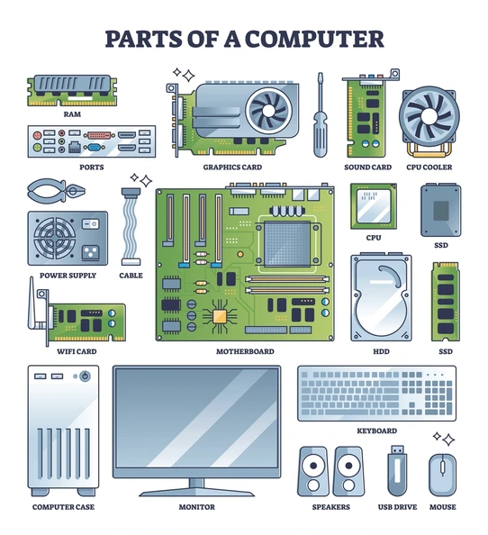
Quiz Reflection
How many got the full mark?
How got more than 50% correct?
How many got them all wrong?
It’s OK either way

Slide 7
Module 1: Computer Hardware Basics

Slide 8

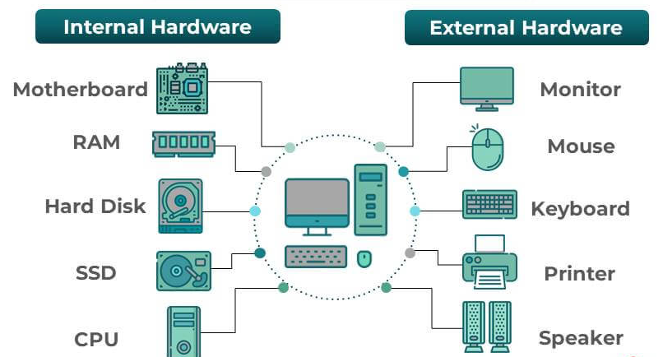
Module 1: Computer Hardware Basics
What is Hardware?
Hardware refers to the physical parts of a computer that you can see and touch:
Internal Hardware: The components inside the computer case that make it work.
External Hardware: The devices outside the computer that you plug in to use it.

Slide 9
Module 1: Computer Hardware Basics
Key Internal Components
CPU (Central Processing Unit): The "brain" of the computer. It performs all the calculations and processing.
RAM (Random Access Memory): The computer's short-term memory. It holds the data for the applications you are actively using. More RAM means you can run more programs at once smoothly.
Hard Drive (HDD or SSD): The computer's long-term storage. This is where your files, applications, and the operating system are saved, even when you turn the computer off. (SSDs are much faster than traditional HDDs).
Motherboard: The main circuit board that connects all the internal components.

Slide 10
Module 1: Computer Hardware Basics
Key External Components
Peripheral | What It Does | Common Port
Monitor | Displays the visual information. | HDMI (common digital), VGA (older)
Keyboard | Used to type information. | USB-A (the classic rectangle)
Mouse | Used to move the cursor and interact. | USB-A
Headset | Used for audio calls, meetings, and listening. | Audio Jack (small circle) or USB-A
Printer | Prints documents. | USB-A or Wi-Fi (network)

Slide 11
Module 1: Computer Hardware Basics
Basic Troubleshooting Steps
Before you call IT, try these simple steps. This solves a surprising number of issues!
"Have you tried turning it off and on again?" A full restart (not just "Sleep") clears the computer's temporary memory (RAM) and fixes many small glitches.
Check Your Cables: Is the monitor cable plugged in securely at both ends? Is the keyboard's USB plug all the way in?
Check the Power: Is the power strip turned on? Is the laptop's charging cable plugged in?

Slide 12

Module 1: Computer Hardware Basics
Quick Discussion
Let's talk about this for a minute:
When your computer monitor suddenly goes black, what's the first thing you should check?
When we talk about "RAM" vs. "Storage," what's the real-world difference for your daily work?
Who is responsible for making sure your keyboard and mouse are plugged in correctly each morning?
Have you ever solved a "big" computer problem with a very simple fix (like a restart)?

Slide 13
Module 2: Professional Communication

Slide 14

Module 2: Professional Communication
Active Listening
Active listening means you are fully focused on and engaged with what the other person is saying.
Pay Attention: Put your phone away. Make eye contact. Avoid side-conversations (in person or in chat).
Show You're Listening: Nod, use small verbal cues like "I see" or "uh-huh."
Paraphrase and Confirm: To ensure you understand, repeat their main point back to them.
Example: "So, if I'm understanding correctly, you need the report by 3 PM, and you want it to focus only on the sales data from last quarter?“
Ask Clarifying Questions: "When you say 'ASAP,' what is the exact deadline you have in mind?"

Slide 15

Module 2: Professional Communication
Effective Communication
Think Before You Speak (or Type): What is the one main point you need to get across?
Be Concise: Avoid rambling. Get to the point quickly and professionally.
Avoid Jargon: Don't use company acronyms or technical terms unless you are sure the other person understands them.
Mind Your Tone: In emails and chats, your tone isn't obvious. Use professional language, and avoid all-caps (which sounds like SHOUTING!).

Slide 16
Module 3: Using Outlook Effectively

Slide 17

Module 3: Using Outlook
The Anatomy of a Professional Email
Clear, Concise Subject Line: This is the most important part!
Bad: Update
Good: Project X: Update on Task 1 - Ready for Review
Good: Question: Deadline for Training Budget

Slide 18

Module 3: Using Outlook
The Anatomy of a Professional Email
Professional Greeting
Standard: “Hi [Name],”
Formal: “Dear [Name],”

Slide 19

Module 3: Using Outlook
The Anatomy of a Professional Email
Concise Body
Purpose: State why you are writing in the first sentence. ("I'm writing to request...")
Details: Provide the necessary background information.
Action: Clearly state what you need from the receiver. ("Please let me know your availability for a 15-minute call.")

Slide 20

Module 3: Using Outlook
The Anatomy of a Professional Email
Polite Closing & Signature
Standard: “Best regards,” “Thanks,” or “Thank you,”
Followed by your name and company signature.

Slide 21
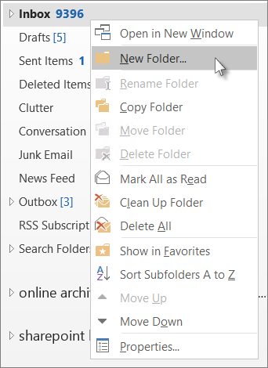
Module 3: Using Outlook
Inbox Organization
Use Folders: Create folders for different projects, departments, or topics. Move emails out of your inbox once you've dealt with them.
Flag for Follow-Up: If you can't respond right away, use the "Flag" feature to create a to-do item.
Delete What You Don't Need: Don't be afraid to delete old marketing emails or newsletters.

Slide 22

Module 3: Using Outlook
Calendar Management
Schedule Meetings: When you create a new "Appointment" or "Meeting," add attendees, a clear title, and a brief agenda in the body.
Respond to Invites: When you receive an invite, respond promptly with Accept, Tentative, or Decline so the organizer knows if you can make it.
Block Your Time: You can create appointments for yourself (e.g., "Focus Time: Work on Report") to block off time and prevent others from scheduling over it.

Slide 23
Module 4: Workplace Etiquette

Slide 24


Module 4: Workplace Etiquette
In the Physical Office
Punctuality: Be on time for work and for any in-person meetings.
Shared Spaces: Keep common areas (breakroom, kitchen, meeting rooms) clean. If you make a mess, clean it up.
Noise Level: Be mindful of your voice volume, especially in open-plan offices. Take personal calls in a private area.
Dress Code: Follow the company's dress code policy.

Slide 25
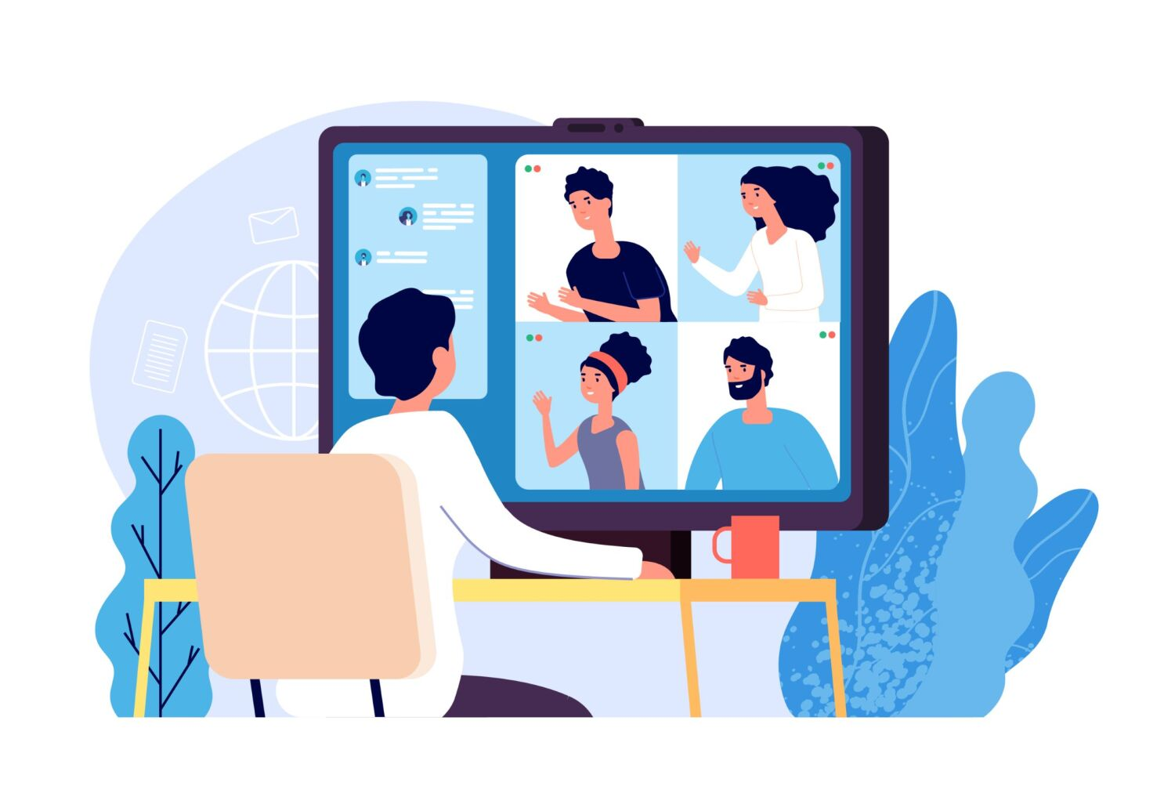
Module 4: Workplace Etiquette
In the Virtual Workplace (Teams, Zoom, etc.)
Be on Time: Punctuality is just as important in virtual meetings.
Mute Yourself: Always mute your microphone when you are not speaking to avoid background noise.
Camera On (If It's the Norm): Check with your manager, but many teams prefer cameras on to improve engagement.
Be Aware of Your Background: Make sure your background is clean and work-appropriate. Use a virtual background if needed.
Use the "Raise Hand" Feature: In larger meetings, use the "Raise Hand" button instead of interrupting.

Slide 26
Module 5: Professional Ethics

Slide 27


Module 5: Professional Ethics
What is Professional Ethics?
Ethics are the moral principles that guide your behavior at work.
Integrity: Doing the right thing, even when no one is watching. This means being honest in your work, your timesheets, and your communications.
Confidentiality: This is critical. You will have access to information that is not public.
Do Not Share: Client lists, financial data, product plans, or personal employee information (like salaries).
Action: If you see a document marked "Confidential" left on a printer, secure it and return it to the owner or report it to your manager.

Slide 28


Module 5: Professional Ethics
What is Professional Ethics?
Ethics are the moral principles that guide your behavior at work.
Accountability: Taking ownership of your responsibilities.
If you make a mistake, don't hide it or blame someone else.
Report the mistake to your manager, and be part of the solution. This builds trust.
Respect: Treat all colleagues, managers, and clients with respect and professionalism, regardless of their role, background, or opinions.

Slide 29
Test your Knowledge
Again!
Please scan the QR code here or go to the below website:
https://afathelbab.github.io/cnpc/computer-basics-soft-skills/day1/quiz.html

Slide 30
Workshop

Slide 31
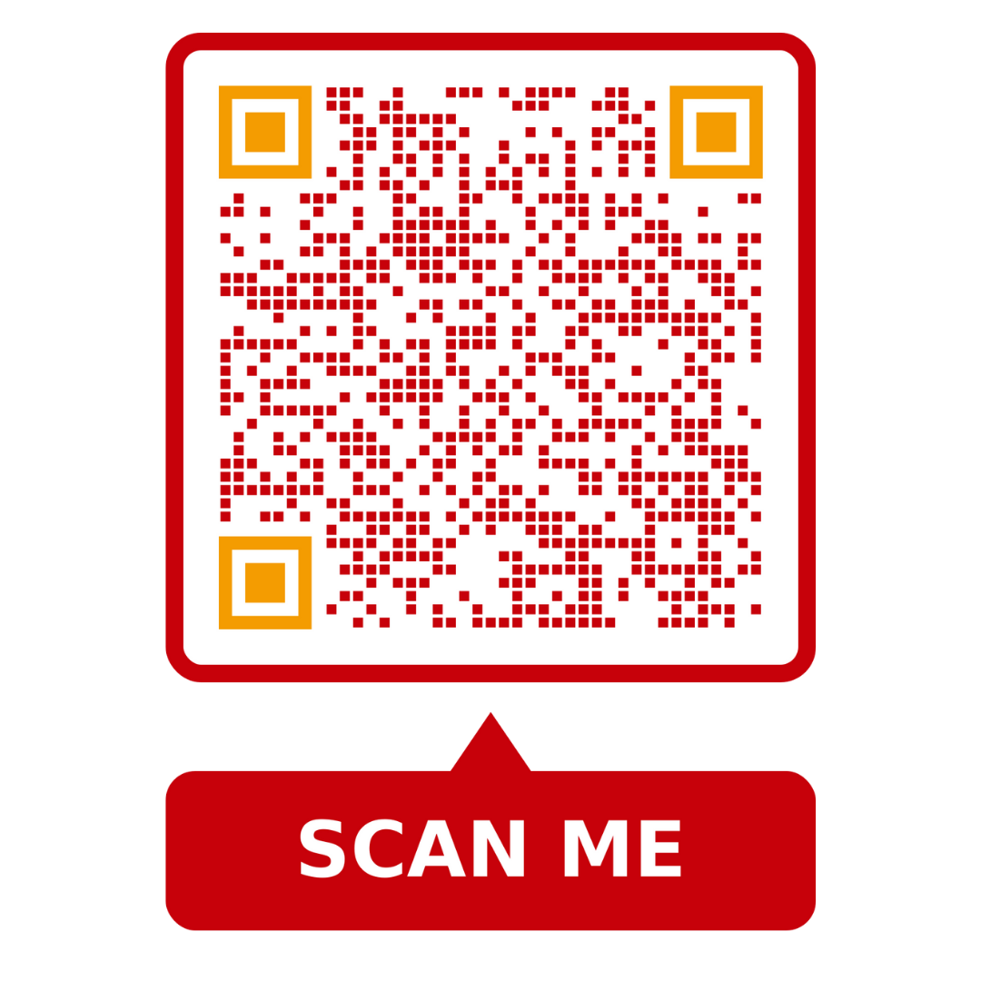

Workshop
https://afathelbab.github.io/cnpc/computer-basics-soft-skills/workshops/

Slide 32



A Better You, A Better Niger
74

